Slide 1
Optimizing Inventory Management for Maximized Profitability
The objective is to review our current inventory management performance and identify areas for improvement to maximize profitability.
The slides includes:
Analyze inventory distribution across ABC categories
Understand SKU distribution and its implications
Review top-performing products
Evaluate correlation between key inventory metrics
Explore price vs. sales dynamics
Analyze sales trends over time
Linkedin
Code
Conclude with actionable recommendations
Yi-Ling Tsai 08/20/204

Slide 2
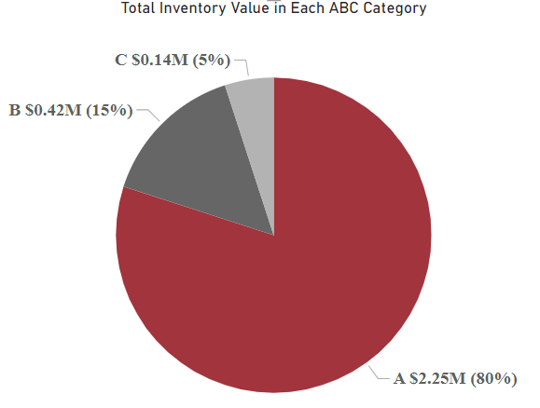
ABC Analysis Overview
Inventory Value Distribution
Key Insights
Visuals
A pie chart depicts the inventory value distribution among A, B, and C categories, while a bar chart shows the total inventory value by each ABC category.
Category A - dominates with 80% of the inventory value, amounting to $2.25M.
Categories B & C - represent 15% ($0.42M) and 5% ($0.14M) of the inventory value, respectively.
The majority of our value is concentrated in Category A, emphasizing the need to prioritize management and optimization efforts on these high-value items.

Slide 3
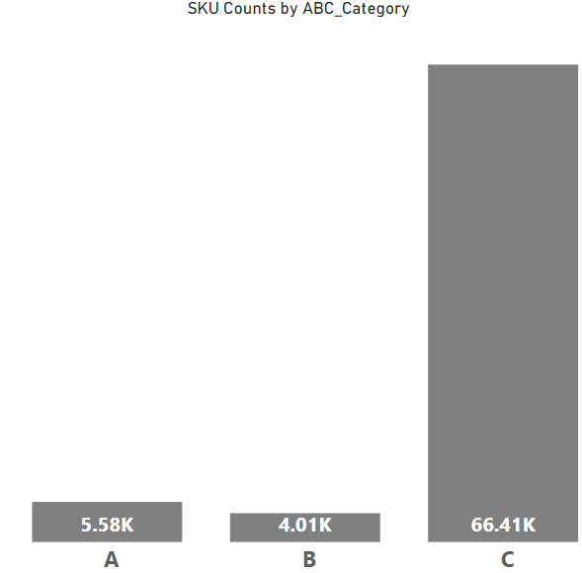
SKU Distribution in ABC Categories
1
Visual Representation
A bar chart illustrates the count of SKUs in each ABC category.
2
Key Insights
Category C has the largest number of SKUs (~67K), but these items contribute the least to total value.
Category A, with around ~6K SKUs, holds the majority of the value.
3
Conclusion
The high SKU count in Category C presents an opportunity to streamline inventory, reducing low-value items to improve efficiency and focus on more valuable SKUs.

Slide 4
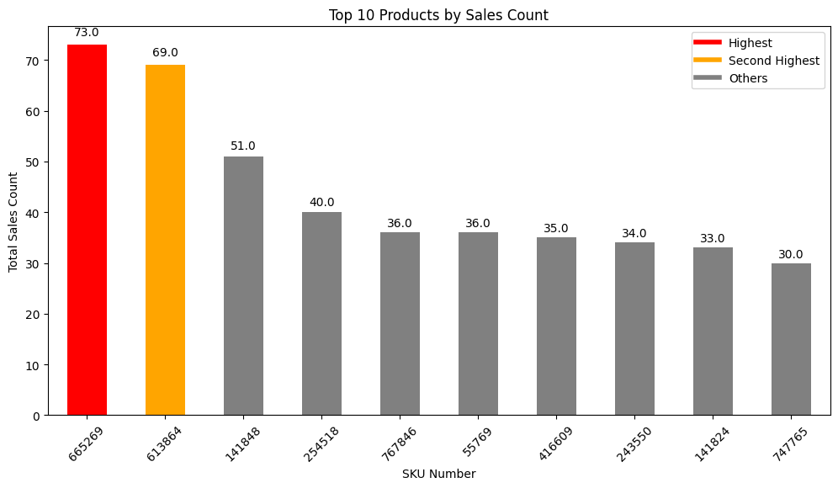
These are the top-performing SKUs by sales count, which represent our highest-demand items. By continuously monitoring these products, we can maximize revenue and adjust our inventory strategy to ensure consistent availability.
Top Performing SKUs
Key Insights: SKUs 665269 and 613864 are the top performers, leading sales significantly. The top 10 SKUs drive a substantial portion of our sales, indicating their critical role in our product portfolio.
Conclusion: Ensuring the availability and strategic marketing of these top-performing SKUs will be crucial for maintaining and boosting sales.
Rank
SKU
Sales Count
1
665269
Highest
2
613864
Second Highest
3-10
Various
Significant

Slide 5
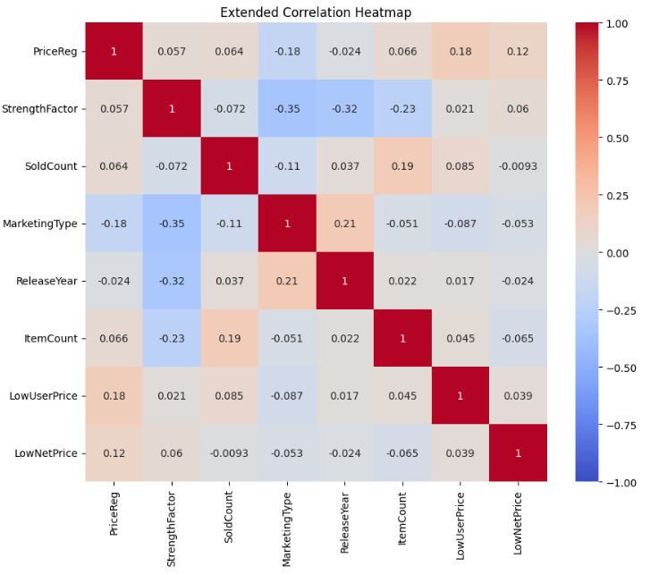
Correlation Insights: Pricing and Sales Dynamics
Key Insights
StrengthFactor vs. MarketingType (-0.35):
Moderate negative correlation suggests that stronger products are marketed differently. Consider aligning marketing strategies to better highlight product robustness.
LowUserPrice vs. PriceReg (0.18):
Weak positive correlation indicates that as regular prices increase, so do low user prices, though the relationship is minimal. Review pricing strategies for effectiveness.
Conclusion
The heatmap suggests that product strength and marketing strategy relationships are noteworthy, while price and sales correlations are weak, indicating a need for further exploration of other sales drivers.

Slide 6



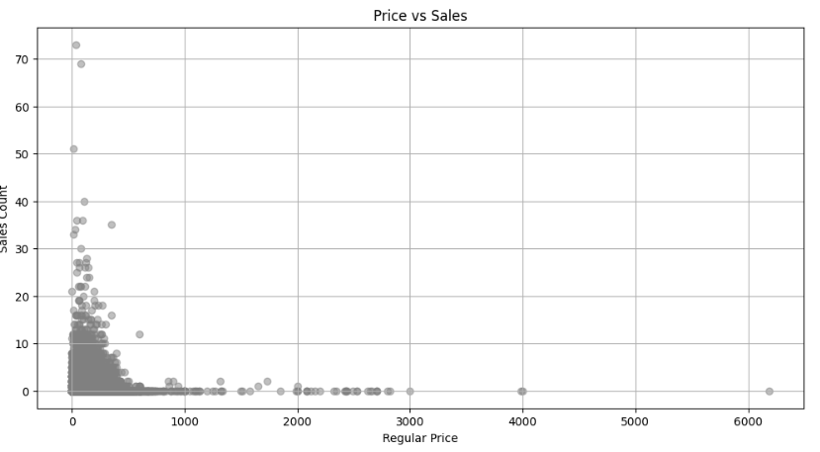
Price vs. Sales Distribution
Visual
Key Insights
Conclusion
Scatter plot showing the relationship between regular price and sales count.
Sales are concentrated heavily on items priced <$1K. There's a clear diminishing return on sales as prices increase, indicating price sensitivity in the market.
This insight points to the need for more competitive pricing strategies or bundling for higher-priced items to boost their sales.

Slide 7
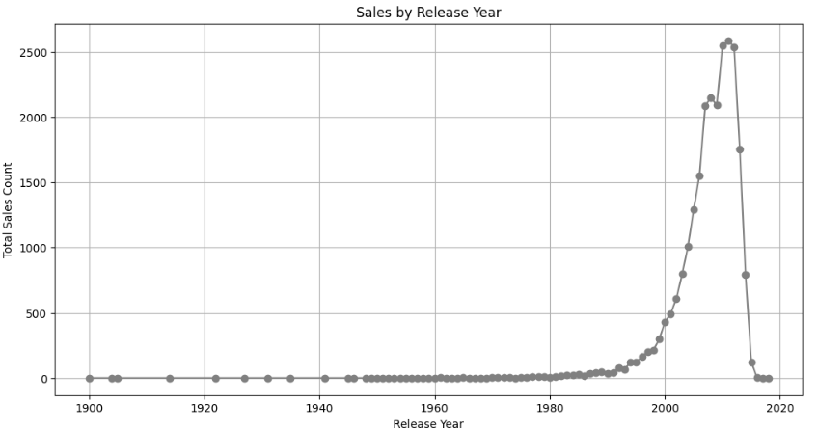
Sales Trends by Product Release Year
1
Visual
Line graph showing the trend of sales by product release year.
2
Key Insights
Sales peaked for products released around the 2000s, followed by a sharp decline in recent years. This decline could indicate market saturation or a shift in consumer preferences.
3
Conclusion
To revitalize sales, we should consider innovating our product offerings or refreshing existing products through updated marketing strategies and price adjustments.

Slide 8
Strategic Recommendations
Focus on Category A
Leverage Sales Data
Prioritize inventory management, stocking, and marketing of Category A items due to their high value contribution.
Maintain and expand efforts on top-selling SKUs, refining pricing strategies to boost the sales of underperforming SKUs.
Streamline Category C
Revisit Product Strategy
Reevaluate and potentially reduce the SKU count in Category C, focusing on eliminating low-value items.
Address the decline in recent sales by exploring new product lines or revitalizing existing products through strategic marketing and pricing.

